Slide 1
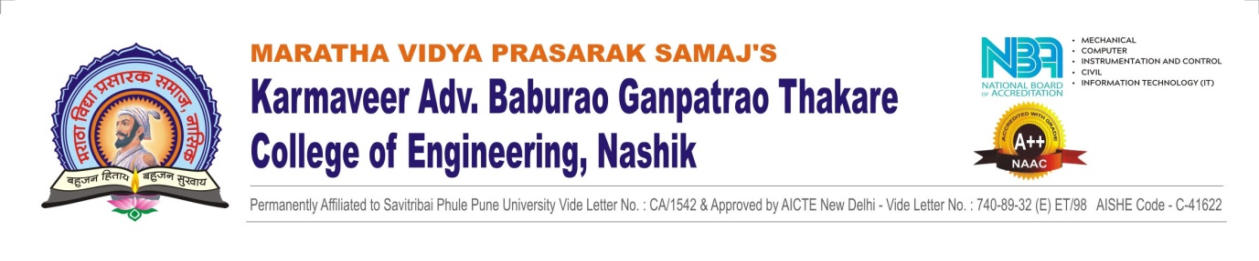


1
Department of Computer Engineering
Project Title : Safeguarding Products Through Blockchain
Group ID: 3
Project Guide : Mrs. R.P Chandwadkar
External Guide : Mr. M. Sharma
Project Group Members :
75) Abhishek Uphade
37) Deepak Kokani
28) Aditya Kalaskar
33) Premroop Khairnar
Indian Writing Instruments PVT. LTD.

Slide 2

Introduction
Problem statement
Motivation
Objectives
Scope of Project
Literature review
Software and hardware requirements
Feasibility
Functinal & Non-Functional Requirements
User Interface
StakeHolder
Methodology
Risks
Time Line Chart
Analysis classes
Use cases
Advantages and Limitations
Conclusion
References

Slide 3

Introduction
Safeguarding products through blockchain is designed to provide a rapid and precise method for determining the authenticity of products by utilizing QR code scanning technology. This innovative approach allows consumers and stakeholders to easily verify the legitimacy of a product by simply scanning the QR code affixed to it using their smartphones or other QR code scanning devices. This streamlined process not only enhances the ease of product verification but also instills greater confidence in consumers, knowing that they can quickly and reliably confirm a product's authenticity.

Slide 4
The proliferation of counterfeit products in the market poses A grave threat to consumers, businesses, and brand integrity. To address this critical issue, we aim to develop an effective system for safeguarding products through blockchain
Problem Statement

Slide 5

Motivation
The motivation for safeguarding products through blockchain is rooted in the desire to create a safer, more reliable, and transparent marketplace that protects consumers, preserves brand integrity, and strengthens overall supply chain integrity.

Slide 6

Objectives
To reduce the financial losses associated with counterfeit goods for both businesses and governments, ultimately benefiting the economy.
To safeguard brand reputation and integrity.
To provide consumers with a secure and user-friendly method to verify the authenticity of products, reducing the risk of purchasing counterfeit goods.
To Emphasize Immutability.

Slide 7

Scope of project
Module 1 : Creation of blockchain
Module 2 : Manufacturer
Module 3 : Add Product
Module 4 : QR-Code Generation
Module 5 : Verifying Seller
Module 6 : Fetching genuine / fake product

Slide 8
Literature Review
Sr. No. | Name of Paper | Description
1 | Fake Product Detection System Using Blockchain , Sunandan Gupta, Research Gate, December 2022 | This system is used to store the supply chain of products at every stage of the transaction of a product to a new party with the help of a QR code.
2 | A Blockchain-Based Application System for Product Anti-Counterfeiting, JINHUA MA, SHIH-YA LIN, XIN CHEN, IEEE Access, February 6 2020 | This system describes a decentralized Blockchain system with products anti-counterfeiting, in that way manufacturers can use this system to provide genuine products
3 | Blockchain-Based Traceability System for Product Recall, IEEE Access, 6 September 2022 | This system proposes to develop a traceability system integrated into the product recall system deployed to the Ethereum to ensure the transparency and visibility of the recall process .

Slide 9

Programming languages: HTML5, CSS3, JavaScript, JSON , Bootstrap, Solidity. Platform : Truffle, Ganache , MetaMask , Ethereum , visual studio, Windows 10 /11 Hardware : RAM = Min. 8GB , CPU = Intel Core i5 / Ryzen 5
Software and Hardware Requirements

Slide 10
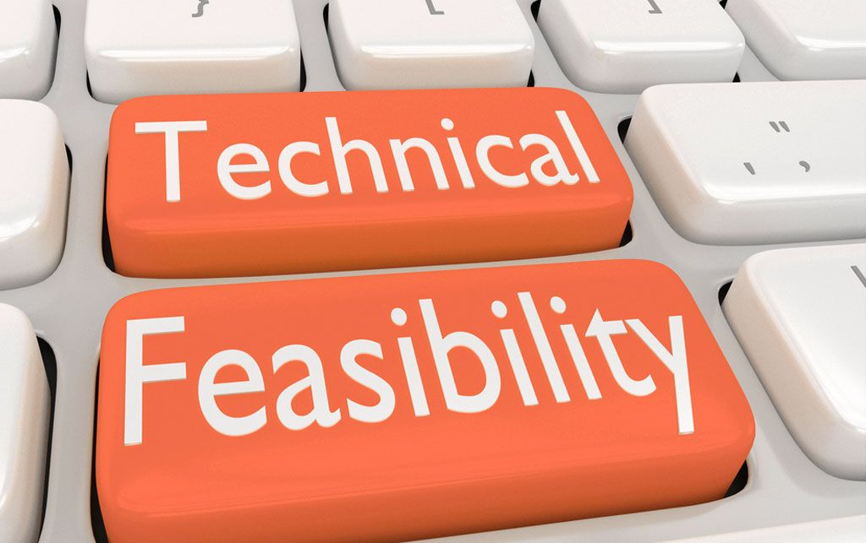
Technical Feasibility
Selecting an appropriate blockchain platform.
Implement strong security measures to protect the blockchain network and the data it stores. This includes encryption, secure access controls, and monitoring for potential threats
Ensure data accuracy and integrity by implementing robust data validation and verification processes.

Slide 11
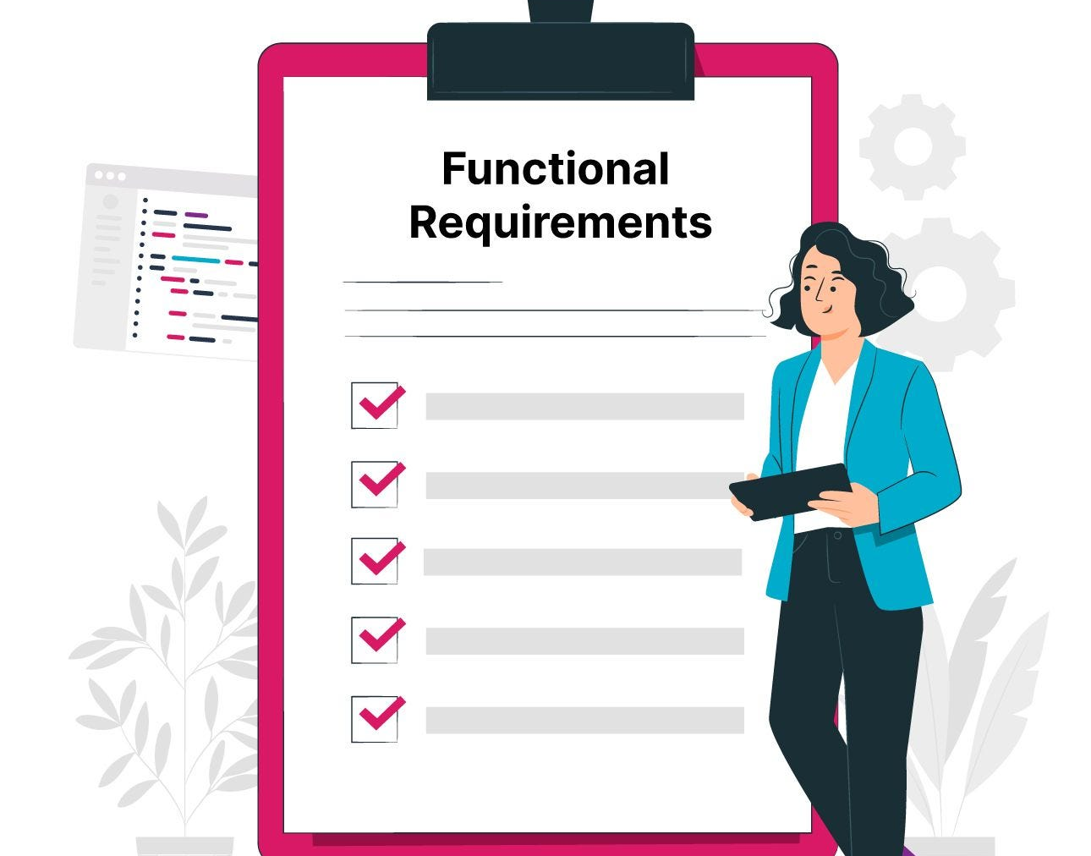
Functional Requirements
Manufacturer Module:
Add Products
Add seller
Sale product to seller
Query seller
Seller Module:
Sell product to consumer
List product for sale
Product for sale
Consumer Module :
See product verification
Purchase history

Slide 12

Non-Functional Requirements
Security
Scalability
Reliability and Availability
Transparency

Slide 13

User Interface
Manufacturer
Seller
Consumer
Product verification

Slide 14

Market Feasibility
There are many people and companies worried about fake products.
Counterfeit products cost the global economy over RS 500 billion a year.
Fake products are a big problem, companies may be willing to pay for a solution.

Slide 15

Financial Feasibility
E = a(KLOC)^b
= 2.4 x (3)^1.05
= 7.6 Person Month
Development Time = c(Efforts)^d
= 2.5 x (7.6)^0.38
= 5.4 Month
Cost : INR 19,800 /-

Slide 16
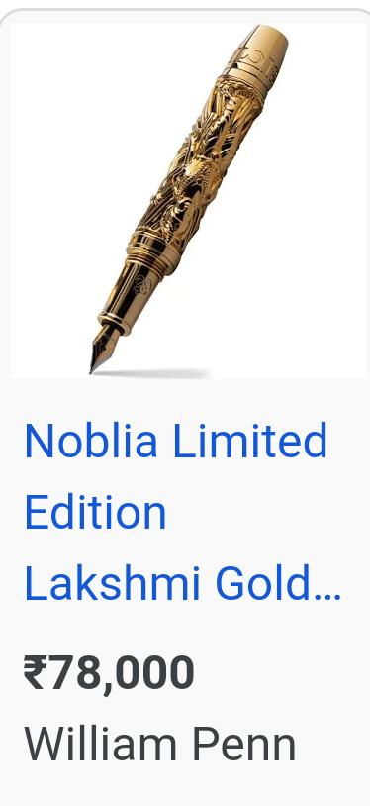

Stakeholder Indian Writing Instruments Pvt. Ltd

Slide 17
Methodology
Step 1: Addition of Product Details.
Step 2: Storing details into the Blockchain Network
Step 3: QR Code Generation
Step 4: Addition of Seller Details
Step 5: Selling product to seller ( Manufacturer to seller )
Step 6: Selling the Product to the consumer (seller to consumer)
Step 7: Product Verification

Slide 18

Risk
Data Integrity and Accuracy:
If product information is inaccurately recorded on the blockchain, it could lead to false negatives (genuine products marked as fake).
Security and Privacy:
While blockchain technology is generally secure, the endpoints (such as devices used for data entry) may still be vulnerable to attacks. If a malicious actor gains access to the system and alters product data.

Slide 19
Time line chart
Month / Year | Event
August 2023 | Identifying and defining problem statement
September 2023 | Conducting feasibility study & literature review
October 2023 | SRS Documentation
November 2033 | System module and design
December 2023 | Selection of technology and tools
January 2024 | Installations
February 2024 | Implementation
March 2024 | System Testing
April 2024 | Deployment of the system

Slide 20

Analysis classes
Product Class
User Class
Blockchain Class
Smart Contract Class
User Interface Class

Slide 21

Use Case
Fashion and Luxury Goods.
Spare Parts Authentication.
Medical Devices.
Agriculture and Organic Products.
Brand Protection.

Slide 22
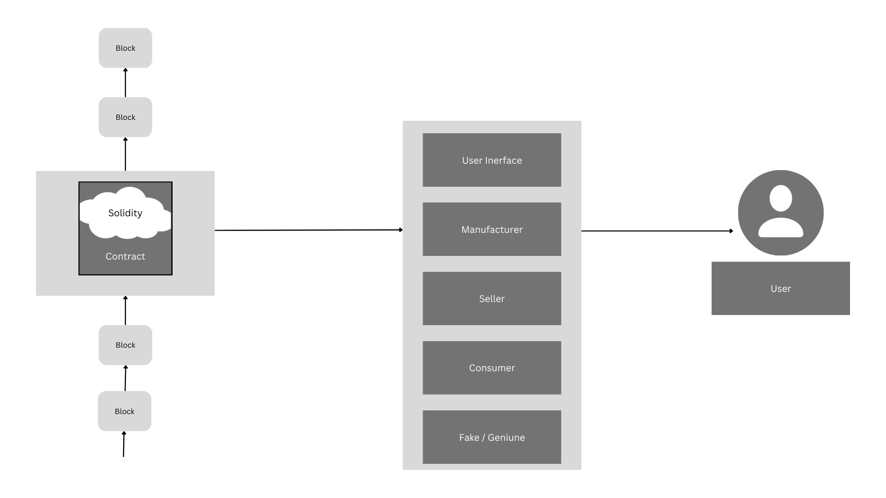
System Architecture

Slide 23
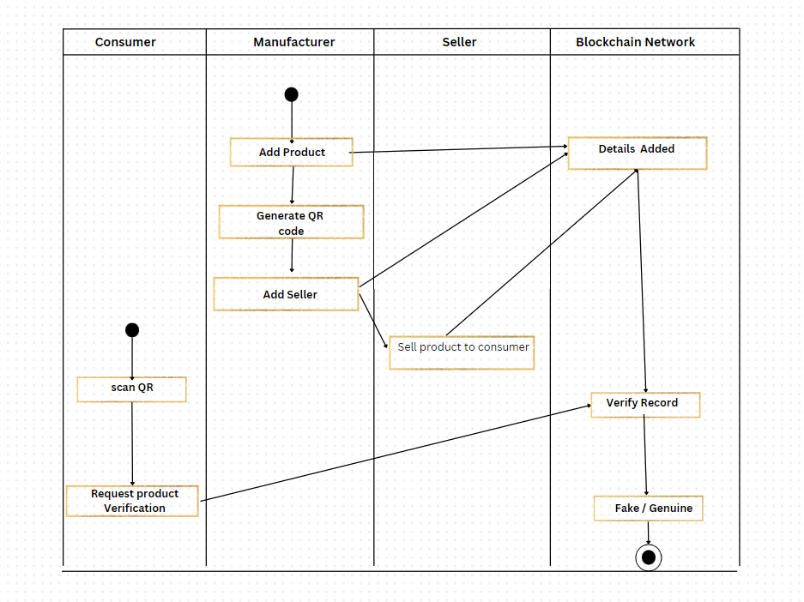
Activity Diagram

Slide 24
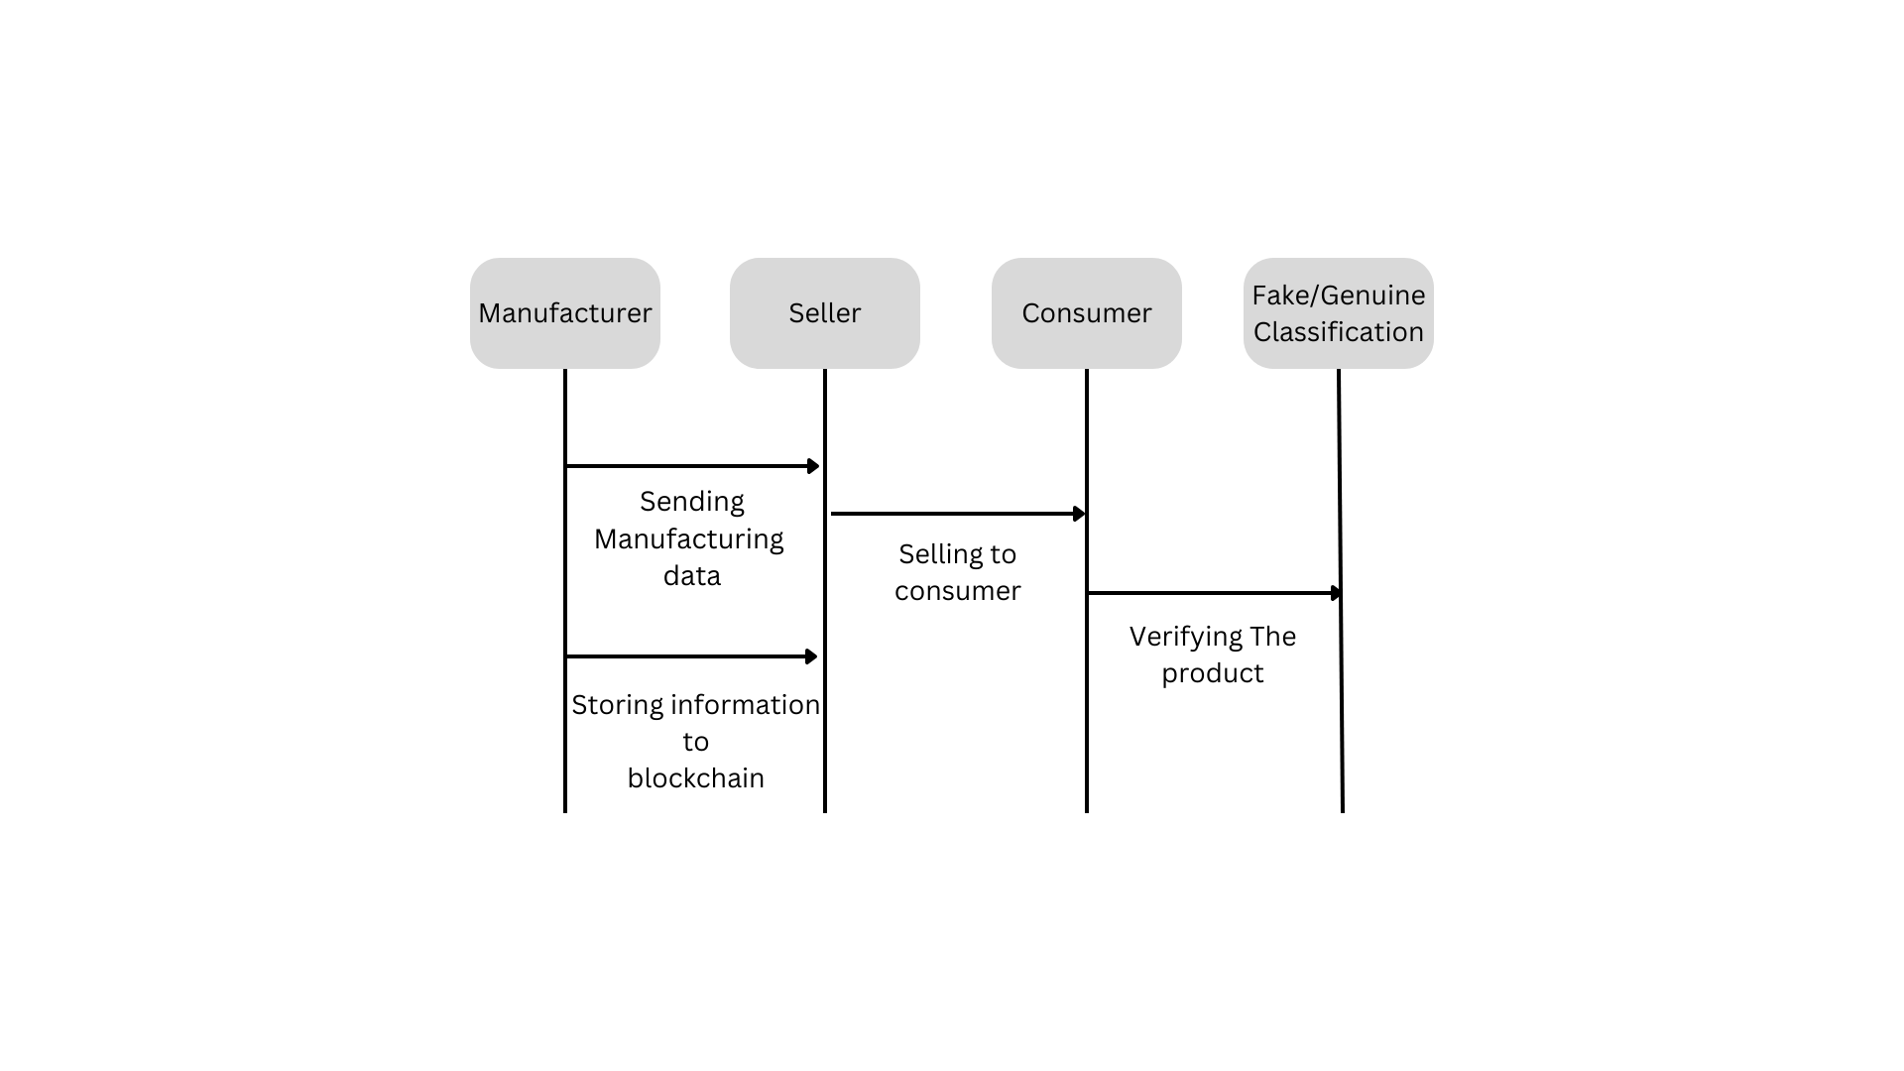
Sequence Diagram

Slide 25
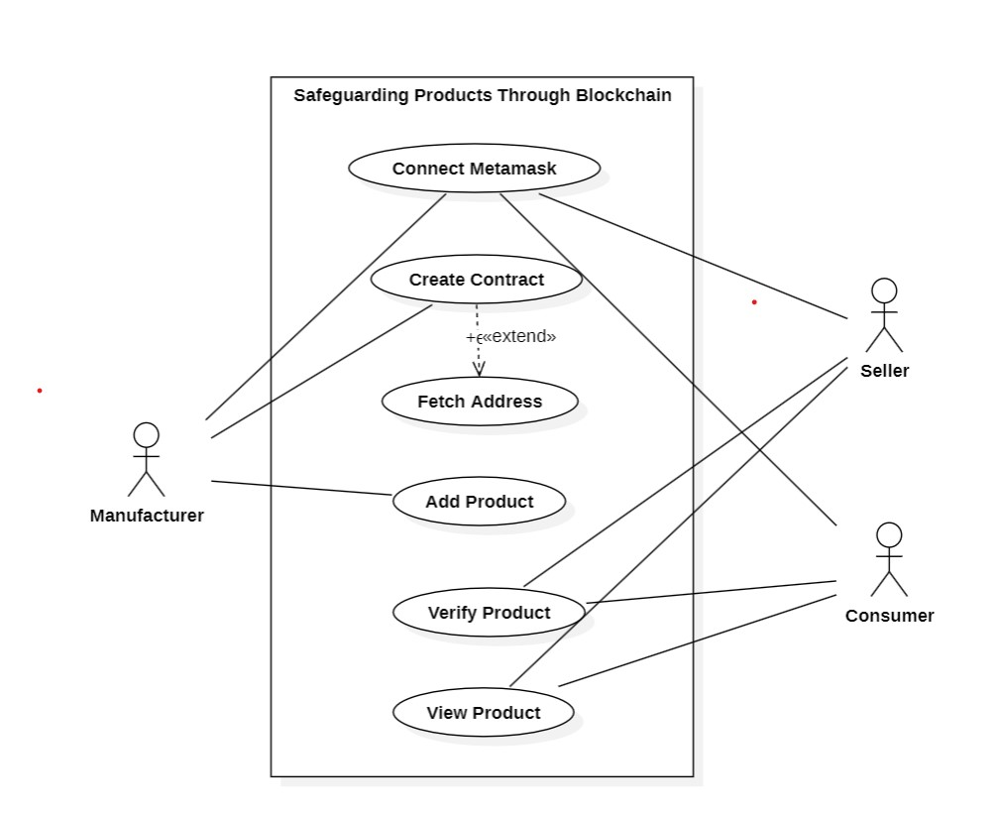
Use Case Diagram

Slide 26
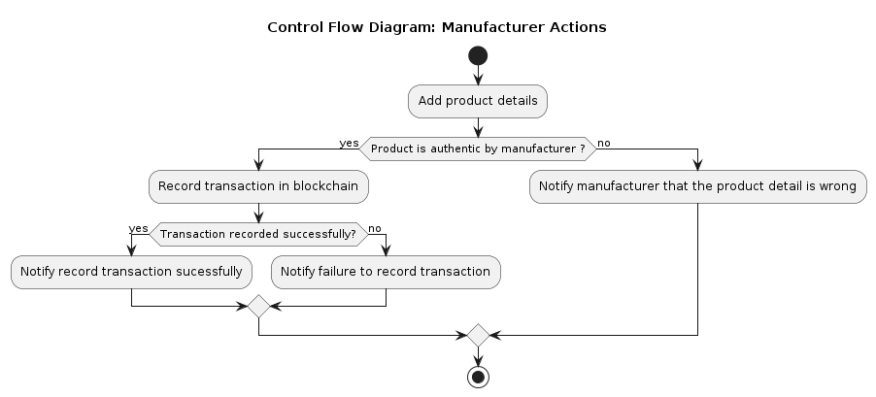
Control Flow Diagram for Manufacture Module

Slide 27
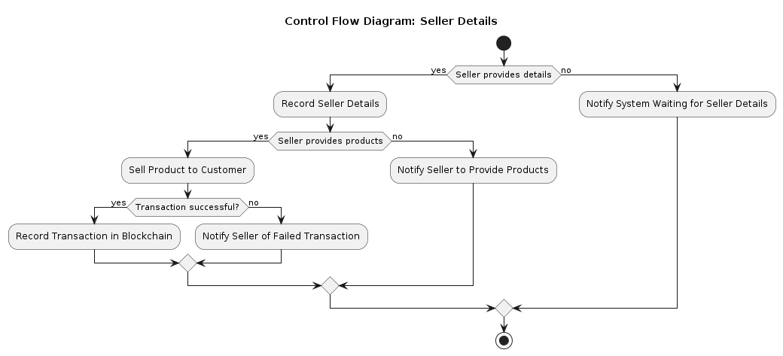
Control Flow Diagram for Seller Module

Slide 28
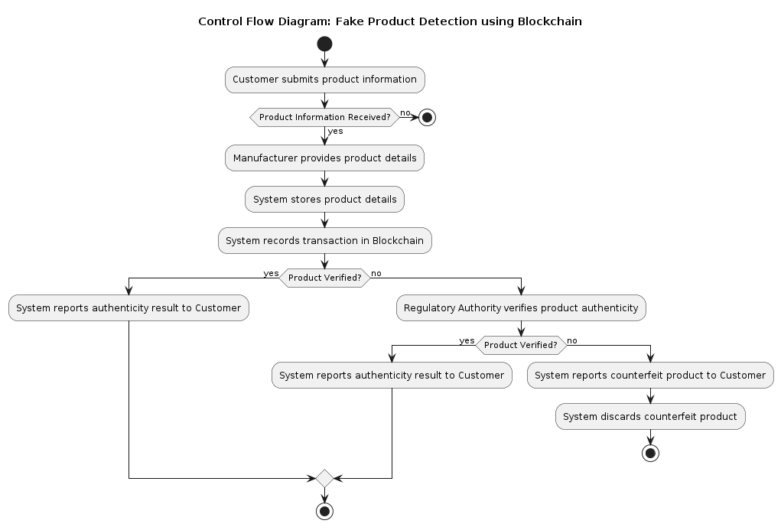
Control Flow Diagram for Consumer Module

Slide 29

Advantages
Immutable Ledger: Blockchain provides a secure and unchangeable ledger of transactions. Once data is recorded, it cannot be altered or tampered with, ensuring the authenticity and integrity of product information.
Transparency and Traceability: The entire history of a product, from its creation to its current state, is visible and traceable on the blockchain. This transparency helps in verifying the authenticity and origin of products.
Authentication Assurance: Consumers and stakeholders can verify the authenticity of products in real-time by checking the information stored on the blockchain. This reduces the risk of purchasing counterfeit or substandard goods.

Slide 30

Limitation
Unauthorized Access: While blockchain is secure, the system must be vigilant against potential security breaches and unauthorized access.
Scalability Issues: The scalability of blockchain networks may present challenges as the volume of transactions and participants increases.
Initial Cost: The initial setup cost for implementing blockchain and IoT technologies may be a barrier for some organizations

Slide 31

Conclusion
The implementation of a Safeguarding products through blockchain technology represents a significant advancement in combating counterfeit goods. Through blockchain’s secure ledger and smart contract automation, the system offers a robust solution for authenticating and tracking products.

Slide 32

References
[1] Sunandan Gupta, ”Fake Product Detection System Using Blockchain”, in December 2022
[2] JINHUA MA, SHIH-YA LIN, XIN CHEN, ”A Blockchain-Based Application System for Product Anti-Counterfeiting”, in February 6 2020
[3] IEEE, ”Blockchain-Based Traceability System for Product Recall”, in 6 September 2022

Slide 33


